Slide 1


Transportation System
(CV705T)
UNIT I
Prof. Yogesh S. Lanjewar
Assistant Professor
St. VINCENT PALLOTTI COLLEGE OF ENGINEERING &
TECHNOLOGY,NAGPUR
DEPARTMENT OF CIVIL ENGINEERING

Slide 2
Transportation engineering
Transportation engineering is the
application of scientific technology and
principles to the planning, functional design, operation and management of facilities for any mode of transportation in order to provide for the safe, efficient, rapid, comfortable, convenient, economical, and environmentally compatible movement of people and goods from one place to other.
2

Slide 3
MODES OF TRANSPORTATION
Basic mode of transportation are
➢Land
Roadway
Railway
➢Water
➢Air
3

Slide 4
MODES OF TRANSPORTATION
Highways
Car, Bus, Truck, non- motorized ..etc
Railways
Trains.
Airways
Aircraft and Helicopters
Waterways
Ships, boats…
4

Slide 5
Airways
Fastest among all other modes
More comfortable
Time saving
Uneconomical
Waterways
slowest among all other modes
This can be possible between ports on the sea
routes or along the river
economical
5

Slide 6
Railways
The transportation along the railways track could be advantageous by railways between the stations both for the passengers and goods, particularly for long distance.
It depends upon the road transport
Safety
Economical
6

Slide 7
Highways
It gives the maximum service to one and all
It gives maximum flexibility for travel with reference to route, direction, time and speed of travel
It provide door to door service
It requires small investment for the government
Motor vehicles are cheaper than other carriers like rail locomotive and wagons
It saves the time for short distance
High degree of accident due to flexibility of movement
7

Slide 8
Scope of highway engineering
Planning and location
Highway design, geometric and structure
Traffic performance and its control
Materials, construction and maintenance
Economic, finance and administration
8

Slide 9
Characteristics of road transport
Roads are used by various types of road vehicles, like passenger cars, buses, trucks, pedal cycle and animal drawn vehicle.
It requires a relatively small investment for the
government.
It offers a complete freedom to road users to transfer the vehicle from one lane to another and from one road to another according to need and convenience.
Speed and movement is directly related to the
accident.
9

Slide 10
HISTORICAL DEVELOPMENT OF ROAD CONSTRUCTION
Oldest mode
Foot paths- animal ways, cart path……..
As civilization evolved the need for transportation increased
ROMAN ROAD
They were built straight regardless of gradient
They were built after the soft soil was removed and a hard stratum was reached.
Thickness varies from 0.75 m to 1.2m
10

Slide 11
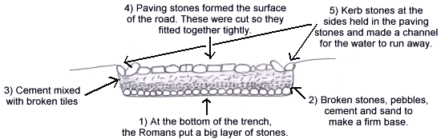
Roman Road Construction Basic cross section
11

Slide 12
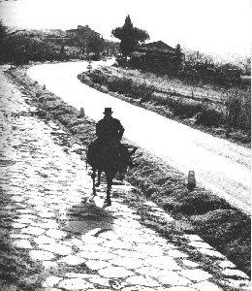
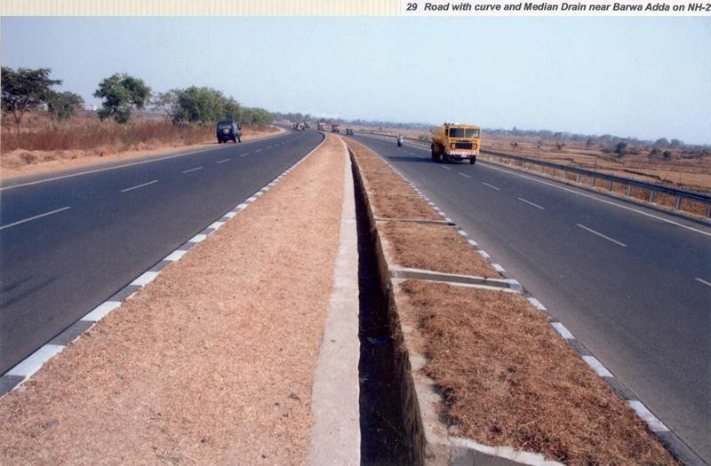
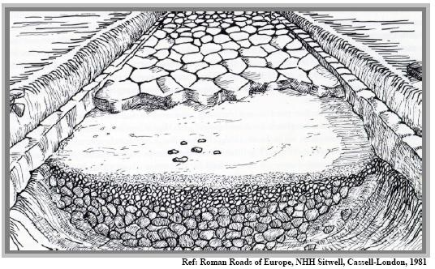
Modern Highway
Roman Roads
12

Slide 13
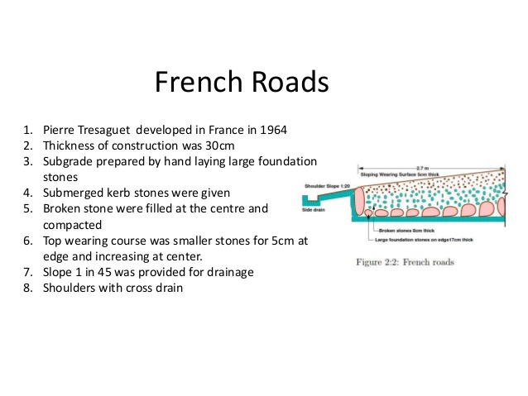
13

Slide 14
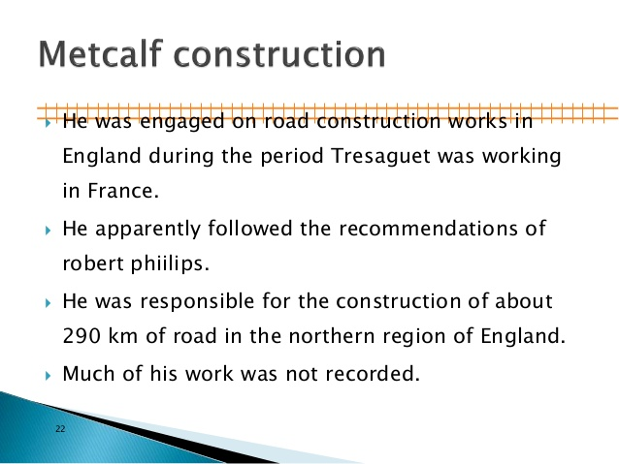



14

Slide 15
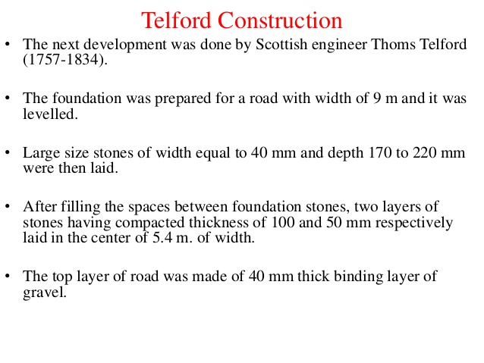
15

Slide 16
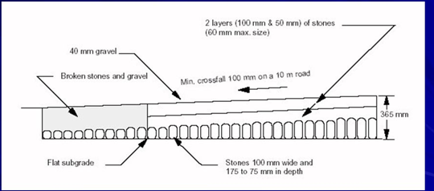
16

Slide 17
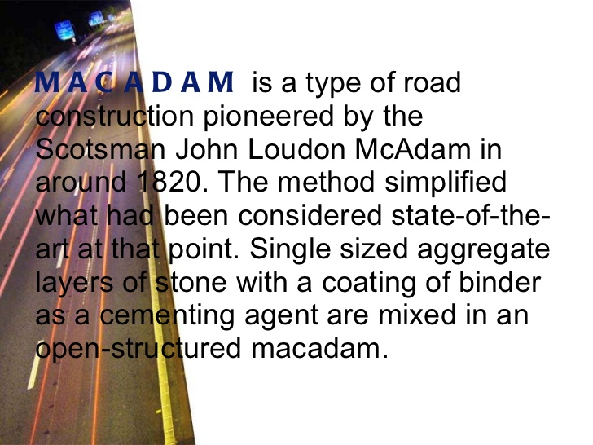
MACADAM CONSTRUCTION

Slide 18
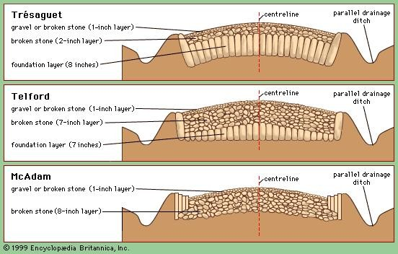
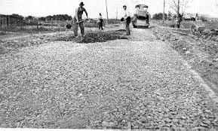
MACADAM CONSTRUCTION

Slide 19
19

Slide 20
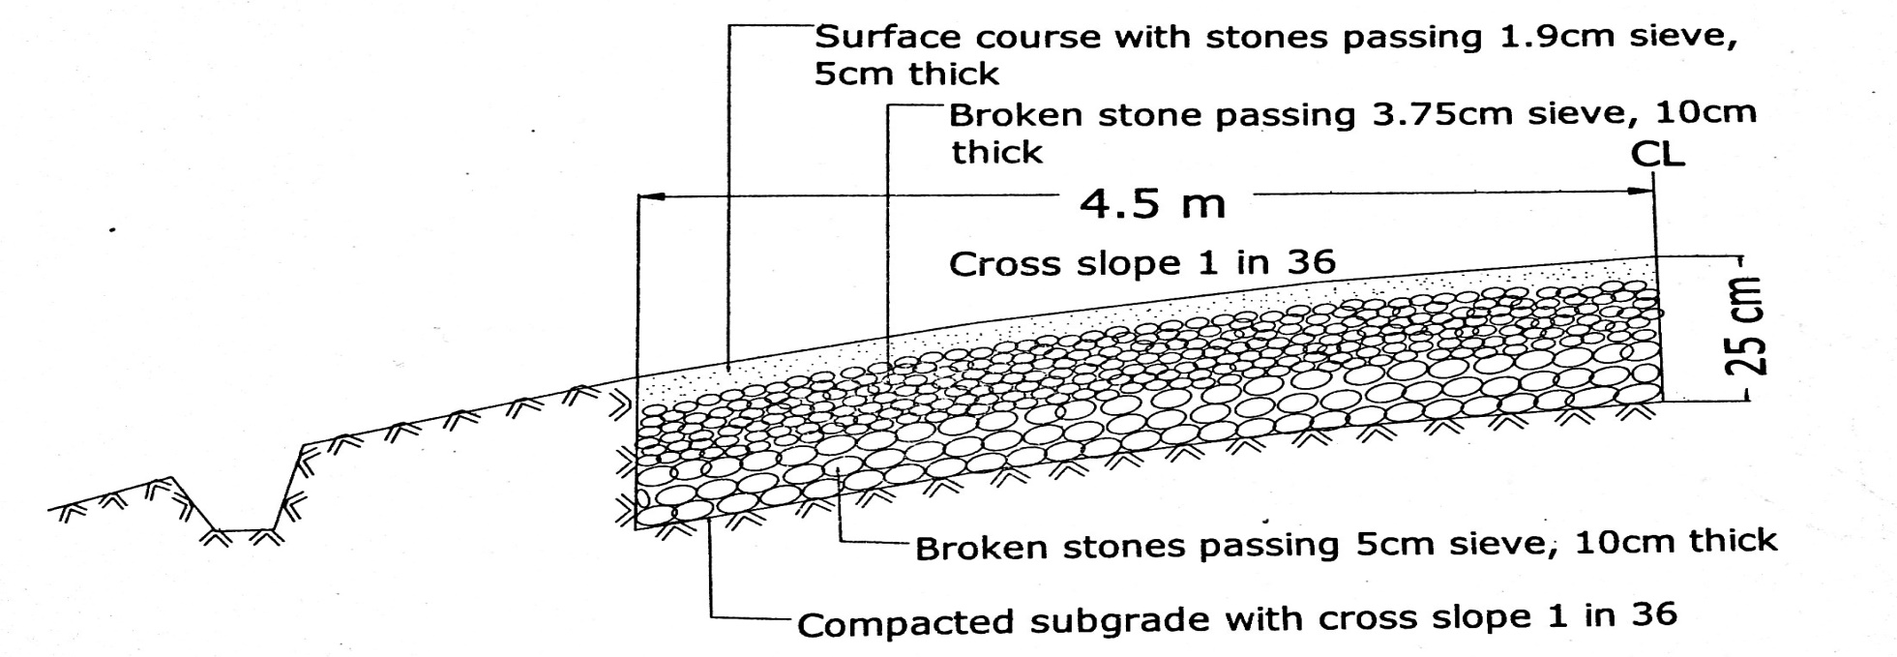
Mechadam Road
20

Slide 21
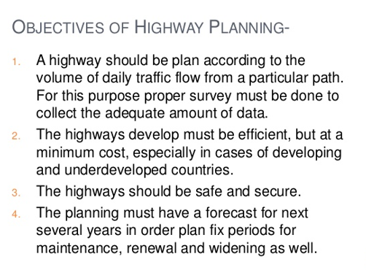
21

Slide 22
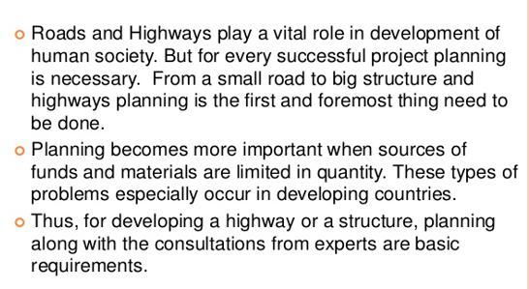
22

Slide 23
Indian Roads
India has a large road network of over 3.314 million kilometers of roadways making it 3rd largest road network in the world.
National Highways - 70,548 Km
State Highways - 1,31,899 Km
Major District Roads - 4,67,763 Km
Rural Roads - 26,50,000 Km
23

Slide 24
Highway Development in India
Jayakar Committee (1927)
Central Road Fund (1929)
Indian Roads Congress (IRC), 1934
Central Road Research Institute (CRRI), 1950
Motor vehicle act (1936)
National Highway Authority of India (NHAI),1995
First twenty year road plan ( 1943-61 )
Second twenty year road plan ( 1961-81 )
Third twenty year road plan ( 1981-2001 )
24

Slide 25
Jayakar Committee,1927
After the first World War, motor vehicle using the roads increases, this demanded a better road network.
In 1927,Indian road development committee was appointed
by the government with M.R. Jaykar as chairman.
Road development in the country should be made as a national interest since local govt. do not have financial and technical capacity for road development.
An extra tax should be on petrol from road users to
create the road development fund.
To create a national level institution to carry research , development works and consultation.
25

Slide 26
Central road fund
It was formed on 1st march 1929
The consumers of petrol were charged an extra 2.64 paisa per litre of petrol to built up this road development fund.
From this 20% of annual reveneu is to be retain as a central reveneu for research and experimental work expenses. etc
Balance 80% is allowed by central govt. to various states based on actual petrol consumption
26

Slide 27
Central Road Fund , 1929
Distribution of 100% on petrol as follows:
➢57.5% for NH
➢30% for SH
➢12.5% for safety works on rail-Road crossing.
50% on diesel for Rural Road development
27

Slide 28
Indian Roads Congress, 1934
Central semi official body known as IRC was formed in 1934.
To provide ideas related to construction and maintenance of highways.
It is a active body controlling the specification, standardization and recommendations on materials, design of roads and bridges.
It publishes journals, research publications and standard specifications guide lines.
28

Slide 29
Motor vehicle act
It was formed in 1939
To regulate the road traffic in the form of
traffic laws, ordinances and regulations.
Three phases primarily covered are control of driver, vehicle ownership and vehicle operation
It was revised on 1988
29

Slide 30
Central road research institute(1950)
engaged in carrying out
projects.
design, construction and
research and development
maintenance of roads
runways, traffic and transportation planning of mega and medium cities, management of roads in different slopes,
Utilization of industrial waste in road construction.
Landslide control.
Ground improvements, environmental pollution.
Road traffic safety.
30

Slide 31
Classification of Highways
Based on the Traffic
Heavy
Medium
Light
Based on location and function ( Nagpur road plan )
National highway (NH)
State highway (SH)
Major district road (MDR)
Other district road (ODR)
Village road (VR)
31

Slide 32
Based on modified system of Highways classification
Primary
Expressways
National Highways
Secondary
State Highway
Major District Road
Tertiary
Other District Road
Village Road
32

Slide 33
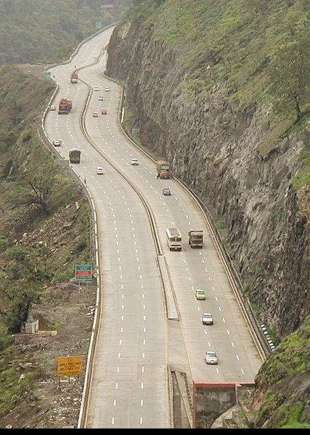
Expressways
Heavy traffic at high speed (120km/hrs)
Connects major points of traffic generation
No slow moving traffic allowed
No loading,
33
The Mumbai-Pune Expressway as seen from Khandala

Slide 34
National Highways
NH are the main highways running through the length and breadth of India, connecting major parts, capital of large states and large industrial and tourist centers.
The national highways have a total length of 70,548 kms. Indian highways cover 2% of the total road network of India and carry 40% of the total traffic.
The highway connecting Delhi-Ambala-Amritsar is denoted as NH---, whereas a bifurcation of this highway beyond Jalandar to Srinagar is denoted NH----A
The longest highway in India is NH--- which stretches from Varansi in Uttar Pradesh to Kanyakumari.
34

Slide 35
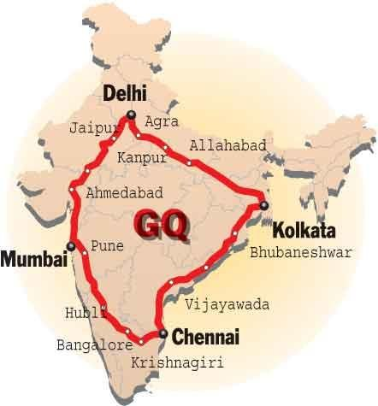
National Highways cont…
The shortest highway is NH47A which stretches from Ernakulam to Kochi and covers total length of 4 Kms.
Golden Quadrilateral – (5,846 K
Kolkata-Chennai-Mumbai
NH-2 Delhi- Kol (1453 km)
➢ NH 4,7 Che-Mum (1290km)
➢ NH5&6 Kol- Che (1684 Km)
NH 8 Del- Mum (1419 km)
ms) connecting Delhi-
)
35

Slide 36
State Highways
They are the roads of a state, connecting up with the national highways of adjacent states, district head quarters and important cities within the state.
Total length of all SH in the country is
1,37,119 Kms.
Speed 80 kmph
36

Slide 37
Major District Roads
Important roads with in a district serving areas of production and markets , connecting those with each other or with the major highways.
India has a total of 4,70,000 kms of MDR.
Speed 60-80kmph
37

Slide 38
Other district roads
serving rural areas of production
and providing
or other
them with outlet to market important roads like MDR or SH.
Speed 50-60kmph
Village roads
centers
They are roads connecting villages or group of villages with each other or to the nearest road of a higher category like ODR or MDR.
ODR+VR out of the total 33,15,231 kms of all type of roads.
Speed-40-50 kmph
38

Slide 39
First 20-years road plan(1943-63)
The conference of chief engineer held at Nagpur in 1943 finalized the first 20-years road development plan for India called Nagpur road plan
Road network was classified into five categories.
The responsibility of construction maintenance of NH was assign to central govt.
The target road length was 5,32,700 km at the end of 1961.
39

Slide 40
First 20-years road plan cont…
The formulae were based on star and grid pattern of road network.
An allowance of 15% is provided for agricultural and industrial development during the next 20-years
The length of railway track in the area was also consider in deciding the length of first category road. The length or railway track is directly subtracted from the estimated road.
40

Slide 41
Second 20-years road plan(1961-81)
It was initiated by the IRC and was finalised in 1959 at the meeting of chief engineers.
It is known as the Bombay road plan.
The target road length was almost double that of Nagpur road plan i.e. 10,57,330 km.
41

Slide 42
Second 20-years road plan cont…
the maximum distance from any place in a semi develop area would be 4.8 Km from any road
Expressways have also been considered in this plan and 1600 km of length has been included in the proposed target NH
Length of railway track is considered
independent of road system
5% are to be provided for future development.
42

Slide 43
Third twenty years road plan (1981-2001)
The future road development should be based on the revised classification of roads system i.e. primary, secondary and tertiary
Develop the rural economy and small towns with all essential features.
Population over 500 should be connected by all roads.
43

Slide 44
Third twenty years road plan
cont…
Expressway should be constructed along major traffic consideration.
All towns and villages with population over 1500 should be connected by MDR and villages with population 1000-1500 by ODR.
Road should be built in less industrialized areas to attract the growth of industries
The existing roads should be improved by rectifying the defects in the road geometry, widening, riding quality and strengthening the existing pavement to save vehicle operation cost and thus to conserve energy
44

Slide 45
Highway alignment and surveys
45

Slide 46
Highway alignment
The position or lay out of centre line of the highway on the ground is called the alignment.
It includes straight path, horizontal deviation and
curves.
Due to improper alignment , the disadvantages are,
Increase in construction
Increase in maintenance cost
Increase in vehicle operation cost
Increase in accident cost
Once the road is aligned and constructed, it is not easy to change the alignment due to increase in cost of adjoining land and construction of costly structure.
46

Slide 47
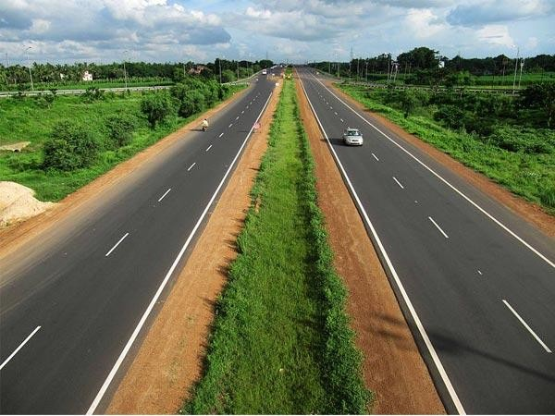
47

Slide 48


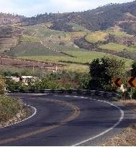
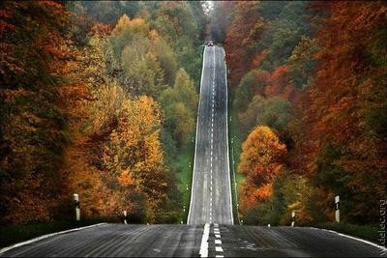
48

Slide 49
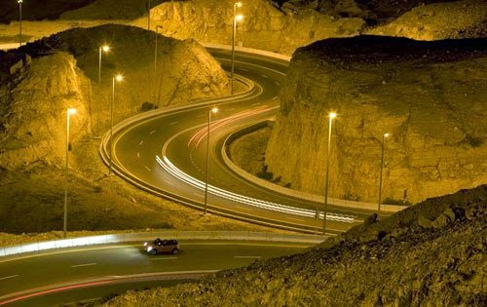
49

Slide 50
Requrements of highway alignment
Short
Easy
Safe
Economical
Short- desirable to have a short alignment between two
terminal stations.
Easy- easy to construct and maintain the road with minimum problem also easy for operation of vehicle.
Safe- safe enough for construction and maintenance from the view point of stability of natural hill slope, embankment and cut slope also safe for traffic operation.
Economical- total cost including initial cost, maintenance cost and vehicle operation cost should be minimum.
50

Slide 51
Factors controlling alignment
Obligatory points
Traffic
Geometric design
Economics
Other considerations
Additional care in hill roads
Stability
Drainage
Geometric standards of hill roads
Resisting length
51

Slide 52
Factors controlling alignment cont...
Obligatory points
Obligatory points through which alignment is to pass
Examples:-bridge site, intermediate town , Mountain pass etc…
Obligatory points through which alignment should not pass.
Examples:-religious places, costly structure, unsuitable land etc…
Traffic
origin and destination survey should be carried out in the area and the desire lines be drawn showing the trend of traffic flow.
New road to be aligned should keep in view the desired lines, traffic flow patterns and future trends.
52

Slide 53
Geometric design
Design factors such as gradient ,radius of curve and sight distance also govern the final alignment of the highway.
Gradient should be flat and less than the ruling gradient or design gradient.
Avoid sudden changes in sight distance, especially near crossings
Avoid sharp horizontal curves
Avoid road intersections near bend
Economy
Alignment finalised based on total cost including initial cost, maintenance cost and vehicle operation cost.
Other consideration
Drainage consideration, political consideration
Surface water level, high flood level
Environmental consideration
53

Slide 54
Topographical control points
The alignment, where possible should avoid passing through
Marshy and low lying land with poor drainage
Flood prone areas
Unstable hilly features
Materials and constructional features
Deep cutting should be avoided
Earth work is to be balanced; quantities for filling and excavation
Alignment should preferably be through better soil area to minimize pavement thickness
Location may be near sources of embankment and pavement materials
54

Slide 55
stability
A common problem in hilly roads is land sliding
The cutting and filling of the earth to construct the roads on hilly sides causes steepening of existing slope and affect its stability.
Drainage
Avoid the cross drainage structure
The number of cross drainage structure should be minimum.
Geometric standard of hilly road
Gradient, curve and speed
Sight distance, radius of curve
Resisting length
The total work to be done to move the loads along the route taking horizontal length, the actual difference in level between two stations and the sum of the ineffective rise and fall in excess of floating gradient. Should kept as low as possible.
55

Slide 56
Engineering Surveys for Highway locations
Before a highway alignment is finalised in highway project, the engineering survey are to be carried out. The various stages of engineering surveys are
Map study (Provisional alignment Identification)
Reconnaissance survey
Preliminary survey
Final location and detailed surveys
56

Slide 57
Drawing and Report
Key map
Index map
Preliminary survey plans
Detailed plan and longitudinal section
Detailed cross section
Land acquisition plans
Drawings of cross drainage and other retaining
structures
Drawings of road intersections
Land plans showing quarries etc
57

Slide 58
New highway project
Map study
Reconnaissance survey
Preliminary survey
Location of final alignment
Detailed survey
Material survey
Geometric and structural design
Earth work
Pavement construction
Construction controls
58

Slide 59
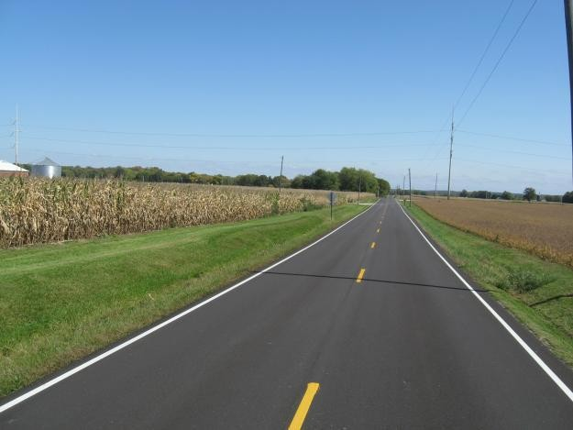
Two lane two-way road
carriageway
59

Slide 60
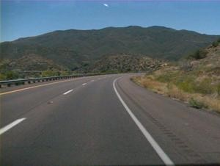
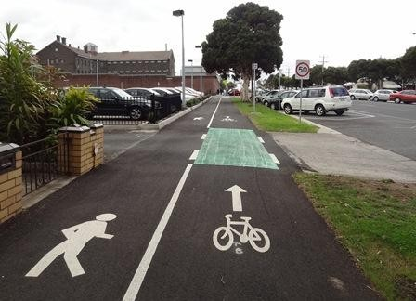
shoulder
Cycle track
Footpath
60

Slide 61
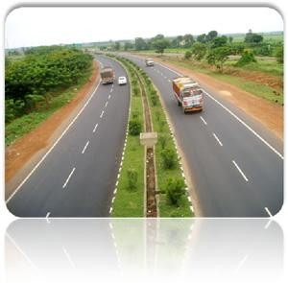
Treated
shoulder
unTreated shoulder
61

Slide 62
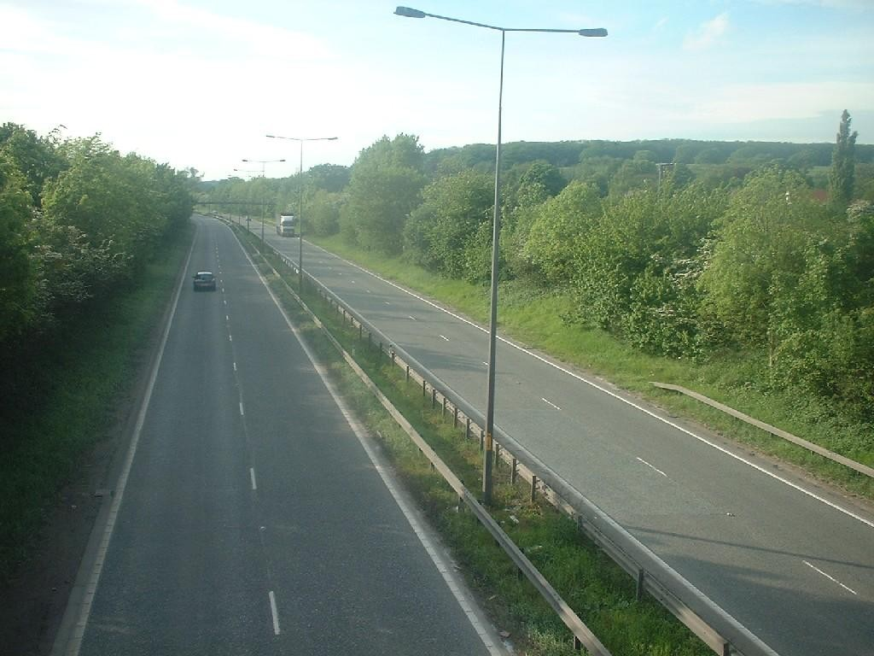
4-lane divided carriage way or dual carriage way
Median/
separator
62

Slide 63
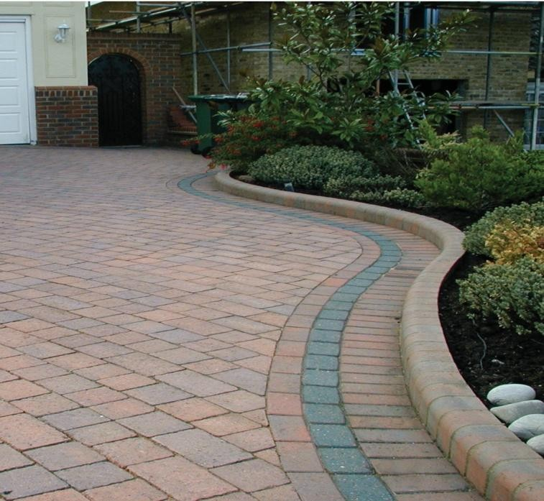
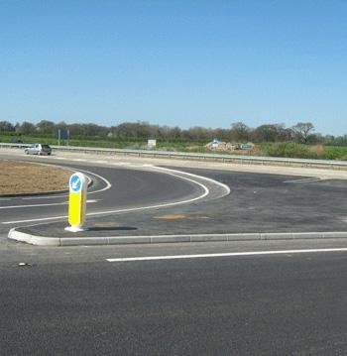
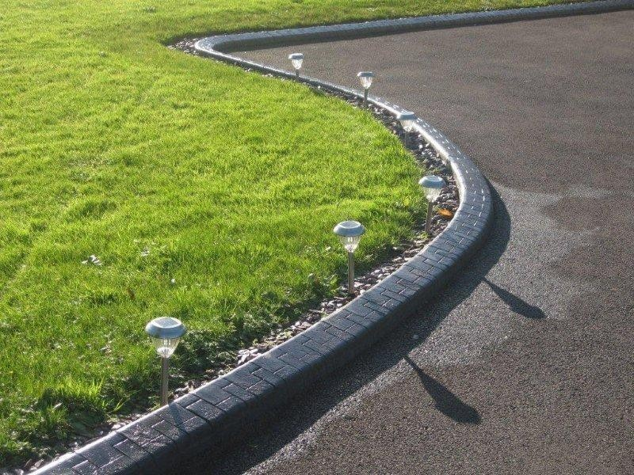
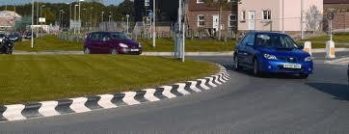
kerb
63

Slide 64
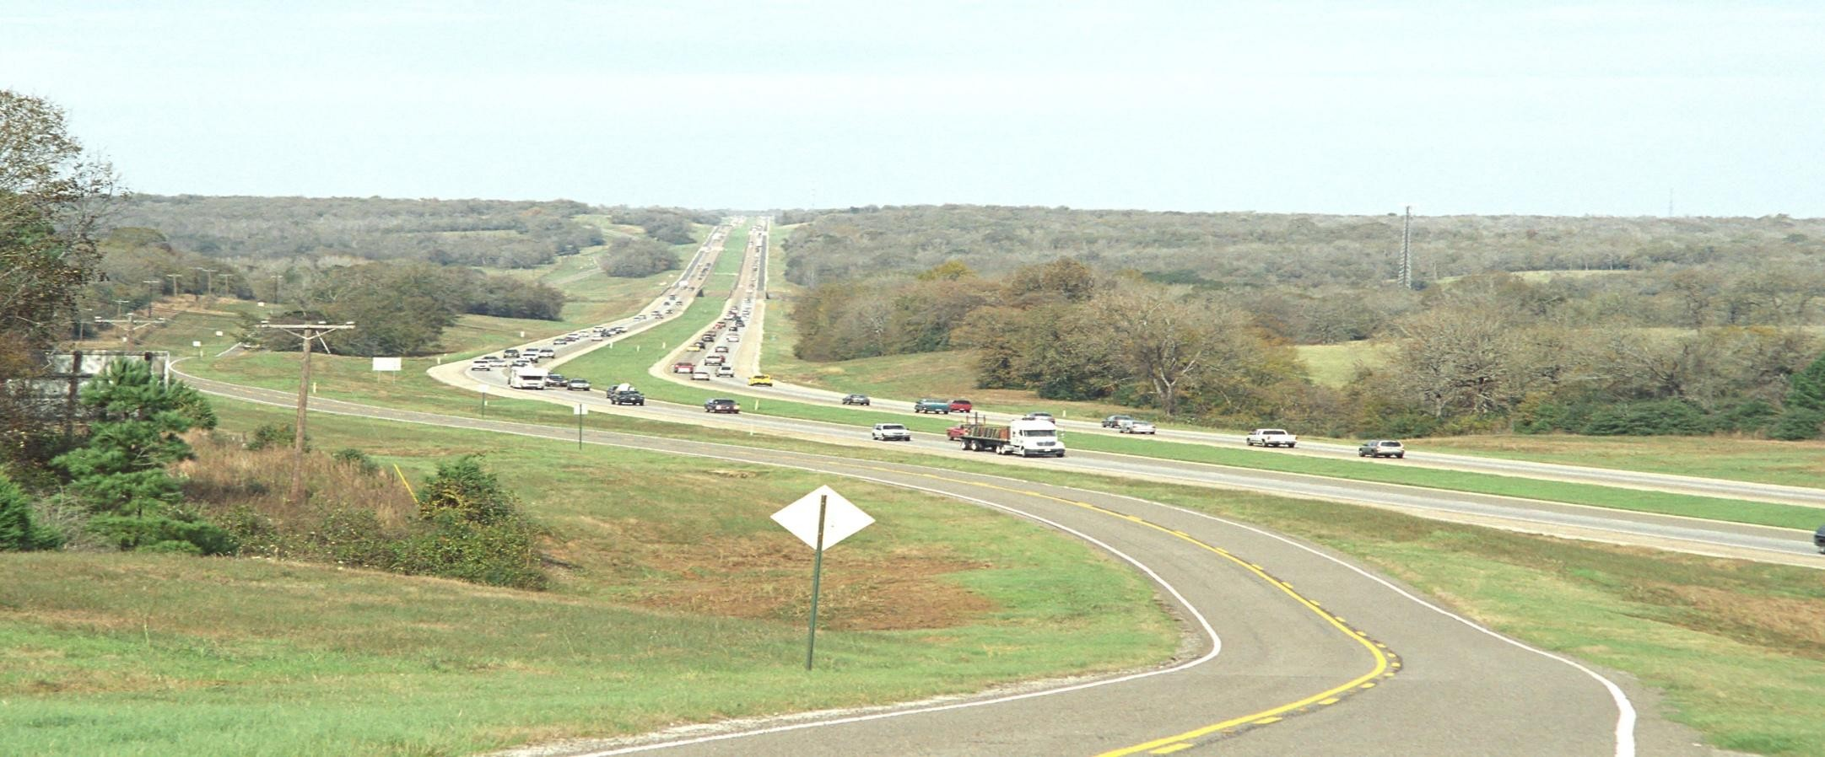
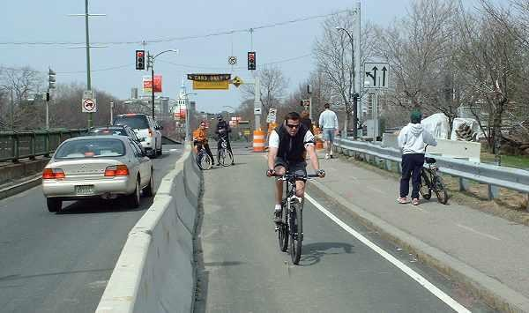
Frontage
road
64

Slide 65
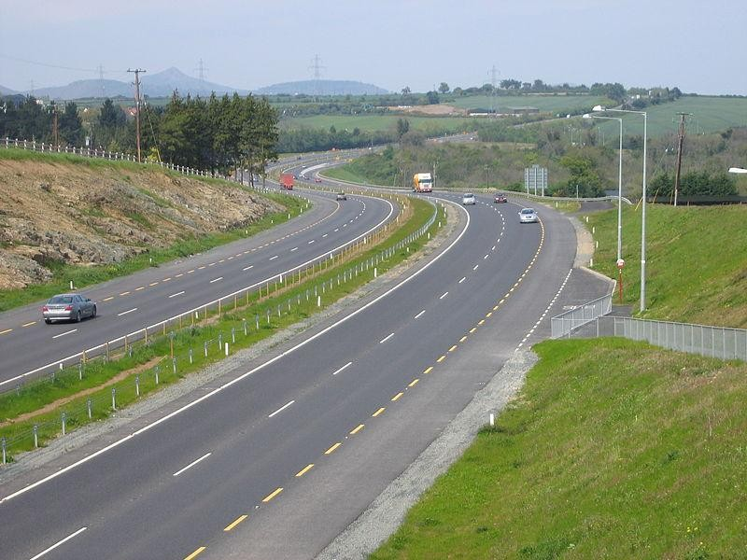
65

Slide 66
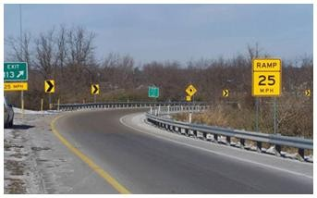
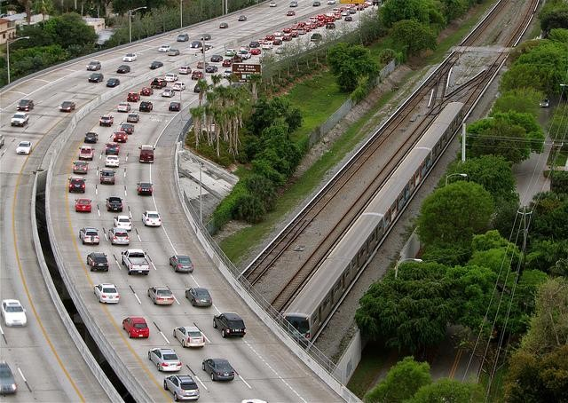
Guard rails
66

Slide 67
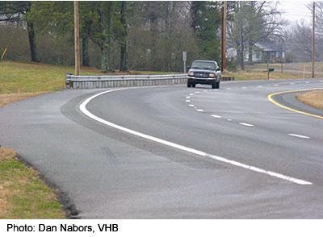
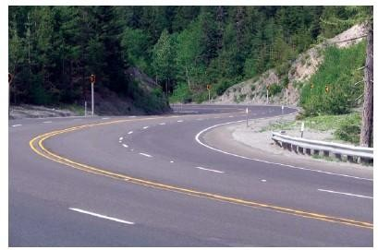
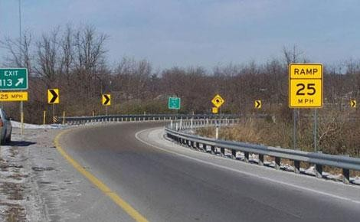
Horizontal
curve
67

Slide 68
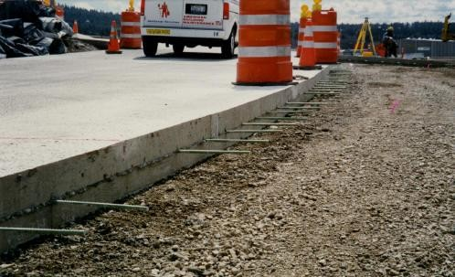
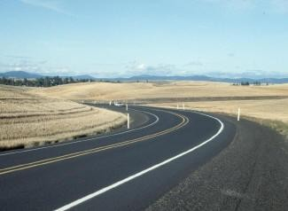
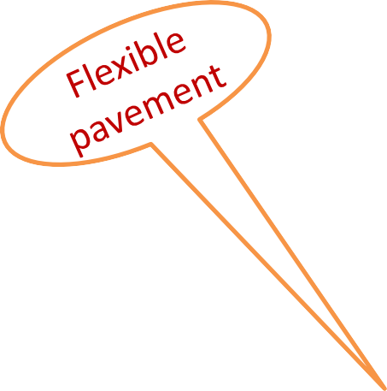
Rigid Pavement
68

Slide 69
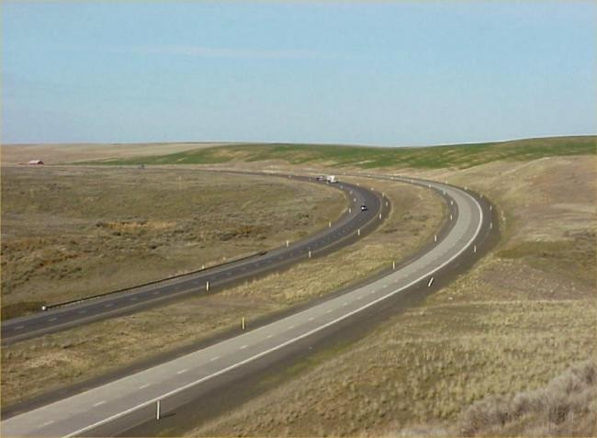
Flexible pavement
Rigid pavement
69

Slide 70
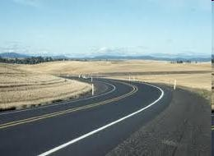
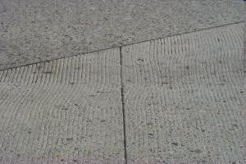
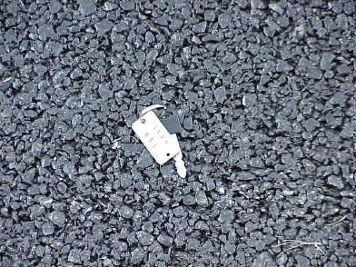
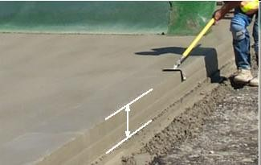
FLEXIBLE PAVEMENT
RIGID PAVEMENT
70

Slide 71
Thank You
71

